Slide 1
CAD Portfolio
Anthony Cacamese

Slide 2
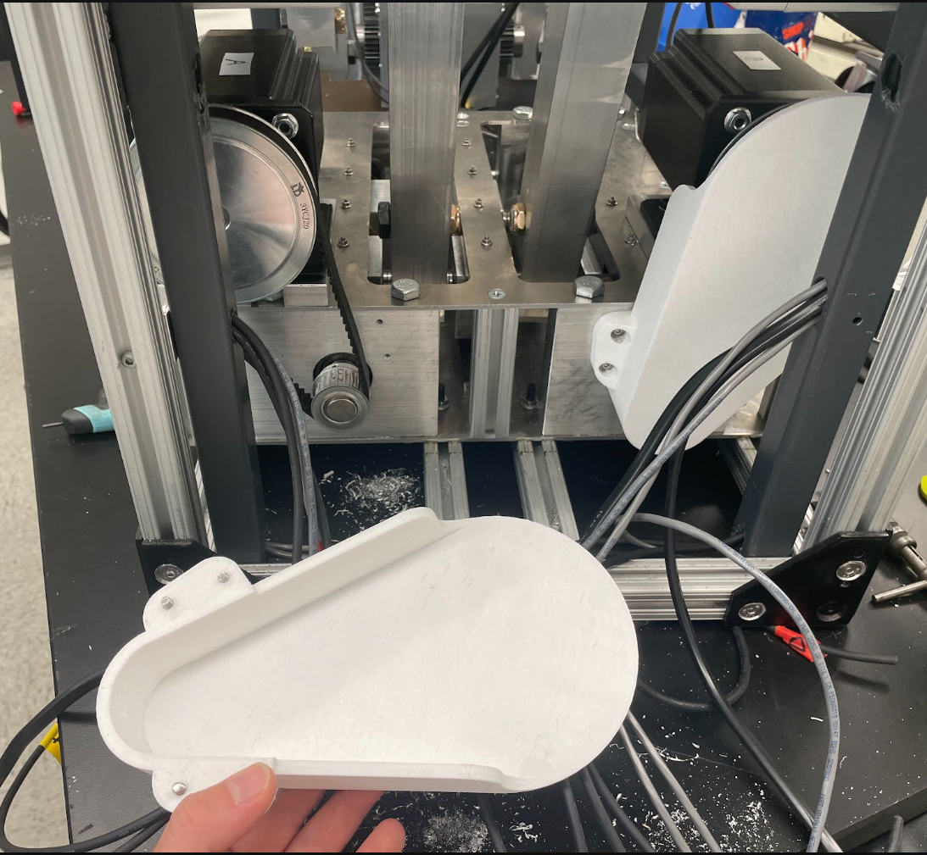
Belt Cover
Summer 2026
Designed to cover belt rotation mechanism for stepper motor in knee rehab device: prevent loose wires in the rear compartment from getting tangled in the belt.
3D Printed

Slide 3
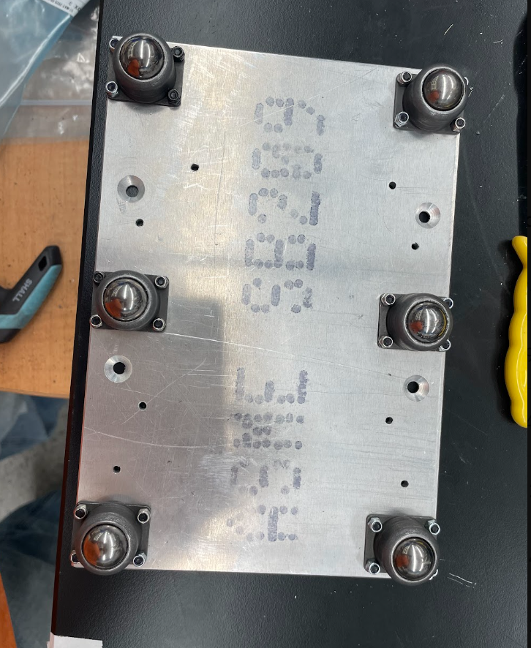
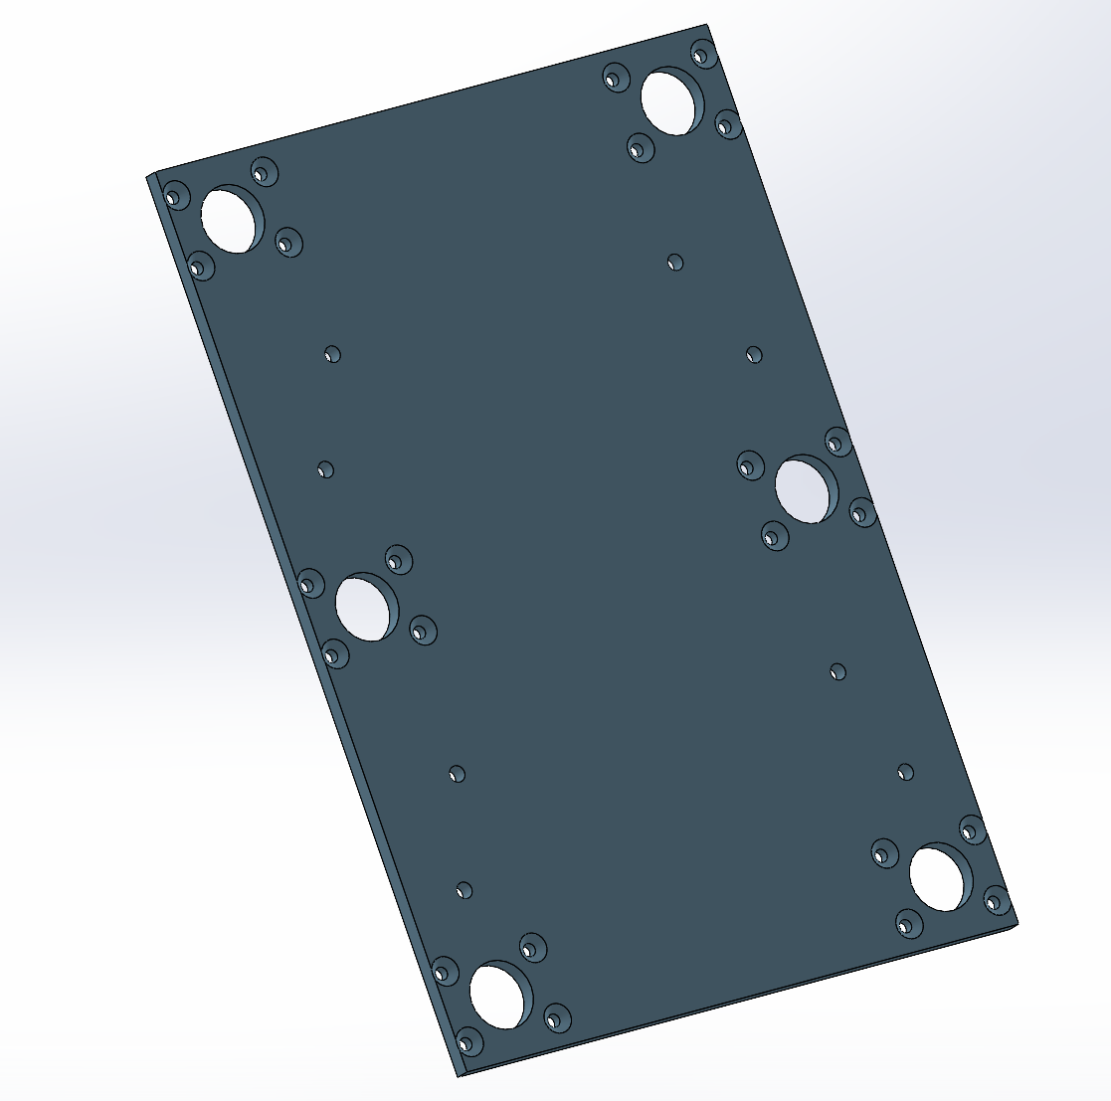
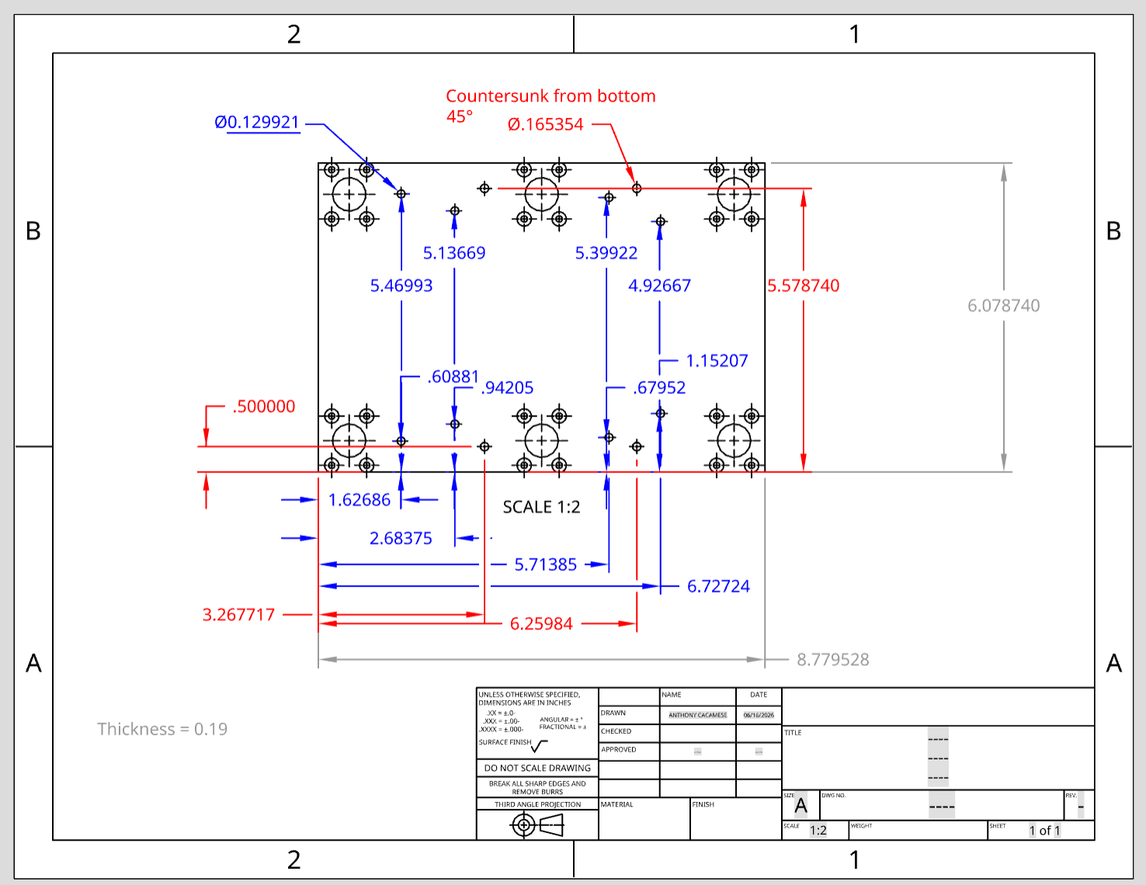
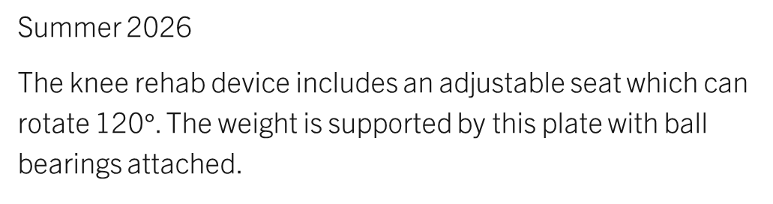

Seat Mechanical Support
Summer 2026
The knee rehab device includes an adjustable seat which can rotate 120$°$. The weight is supported by this plate with ball bearings attached.
Created technical drawing, then cut in machine shop.

Slide 4
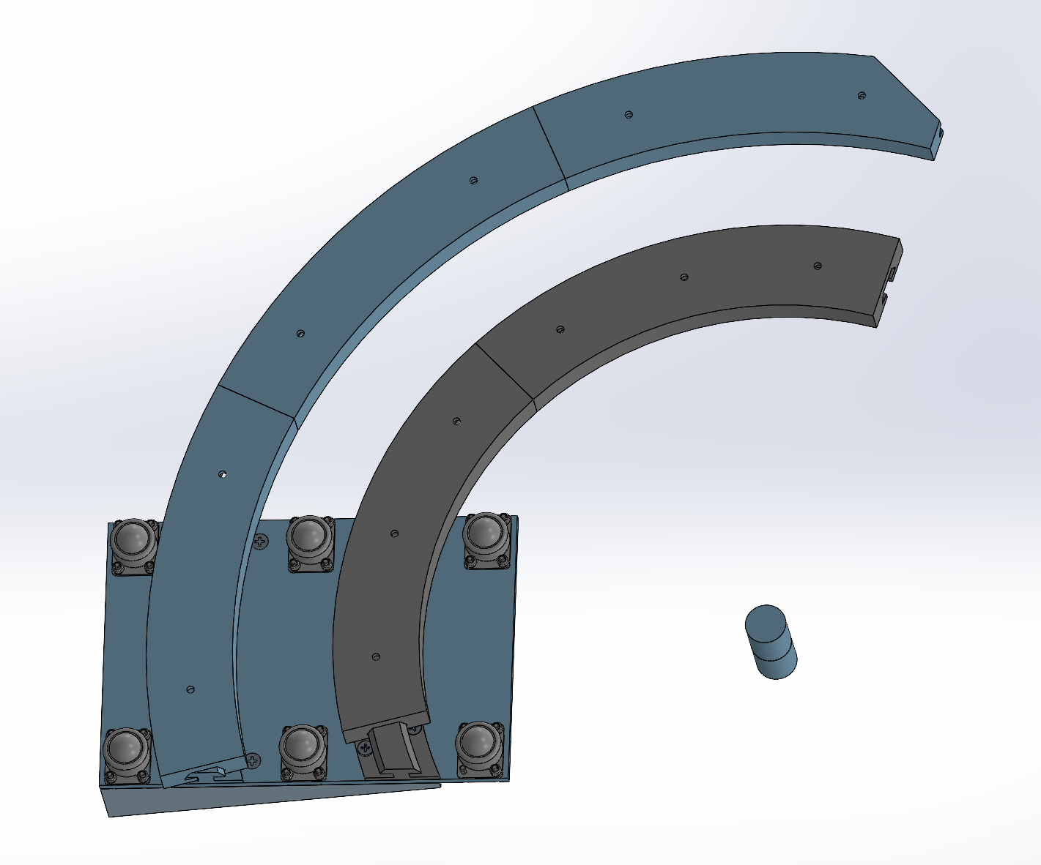
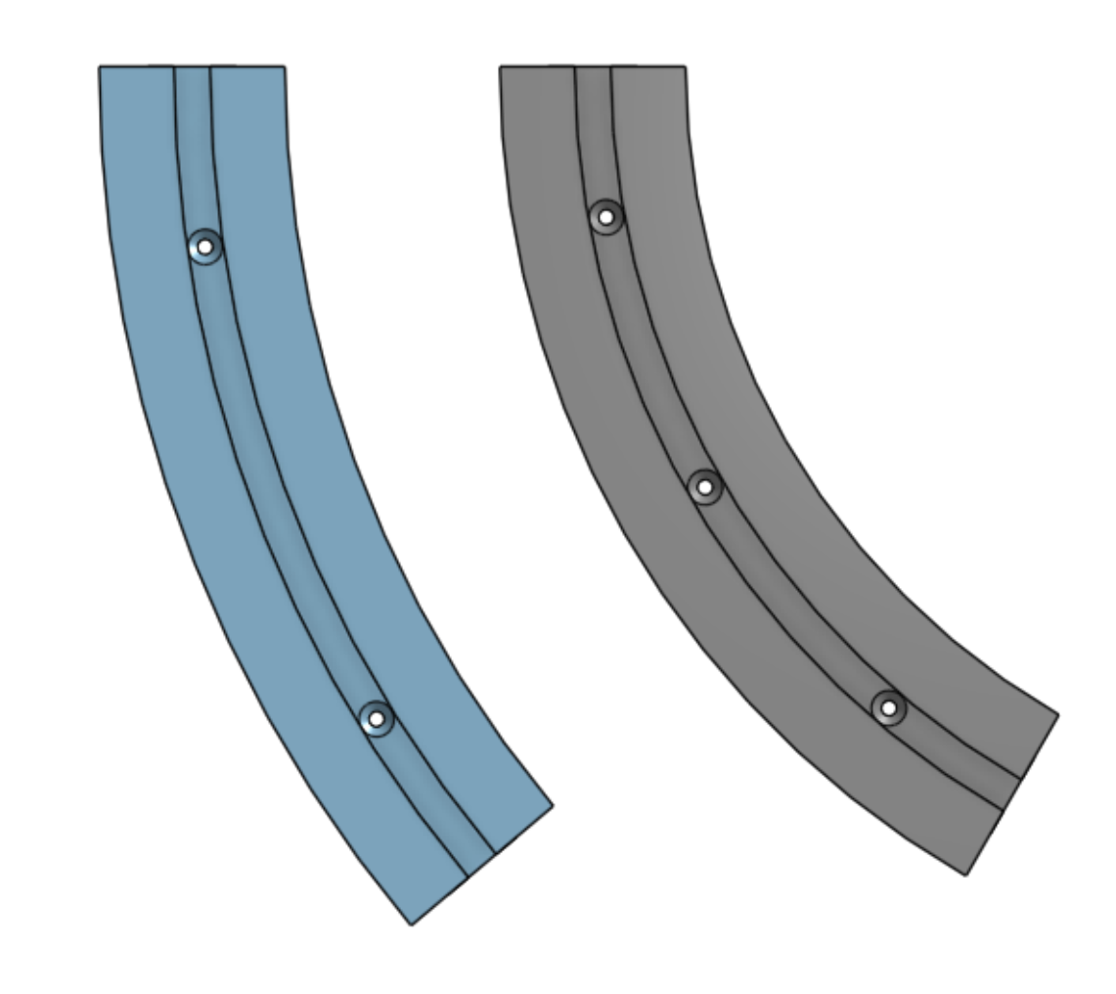
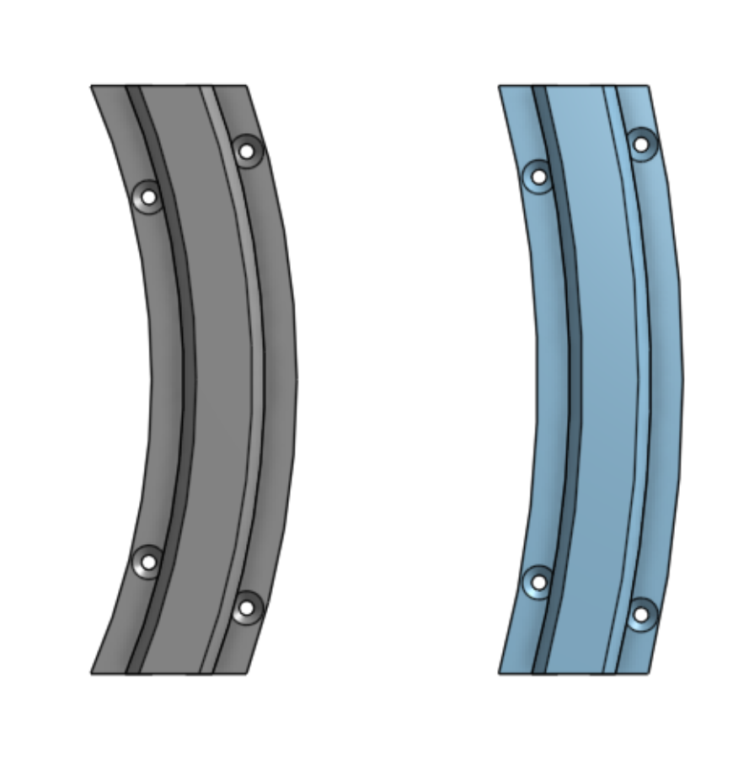
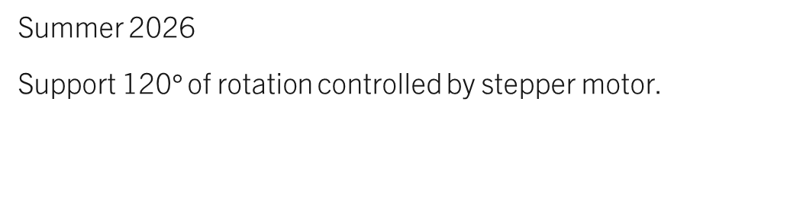
Seat Tracks
See entire assembly shown from below including axis of rotation. Brackets are screwed down while plate with ball bearings is free to travel along track.
Summer 2026
Support 120$°$ of rotation controlled by stepper motor.
Lower parts and corresponding upper parts.
3D Printed using polycarbonate (iterations ongoing)

Slide 5
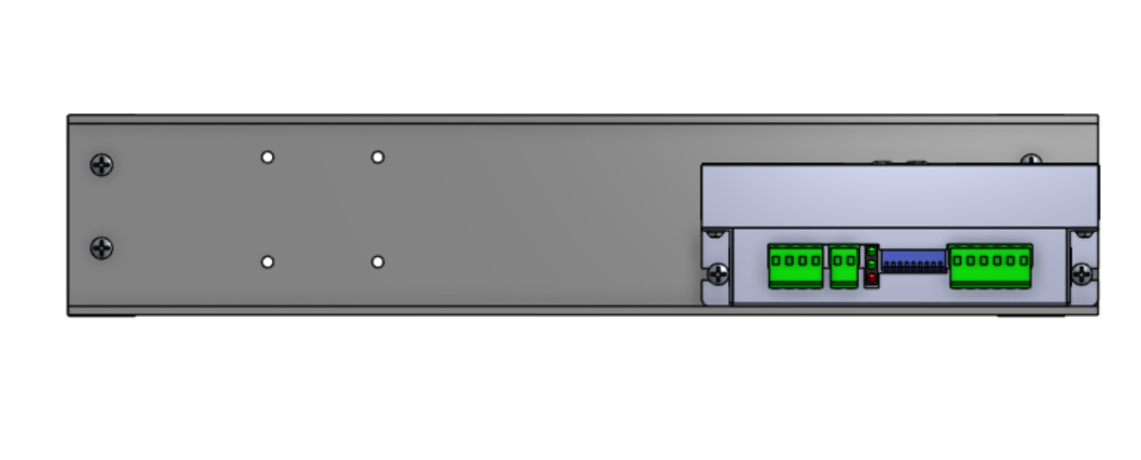
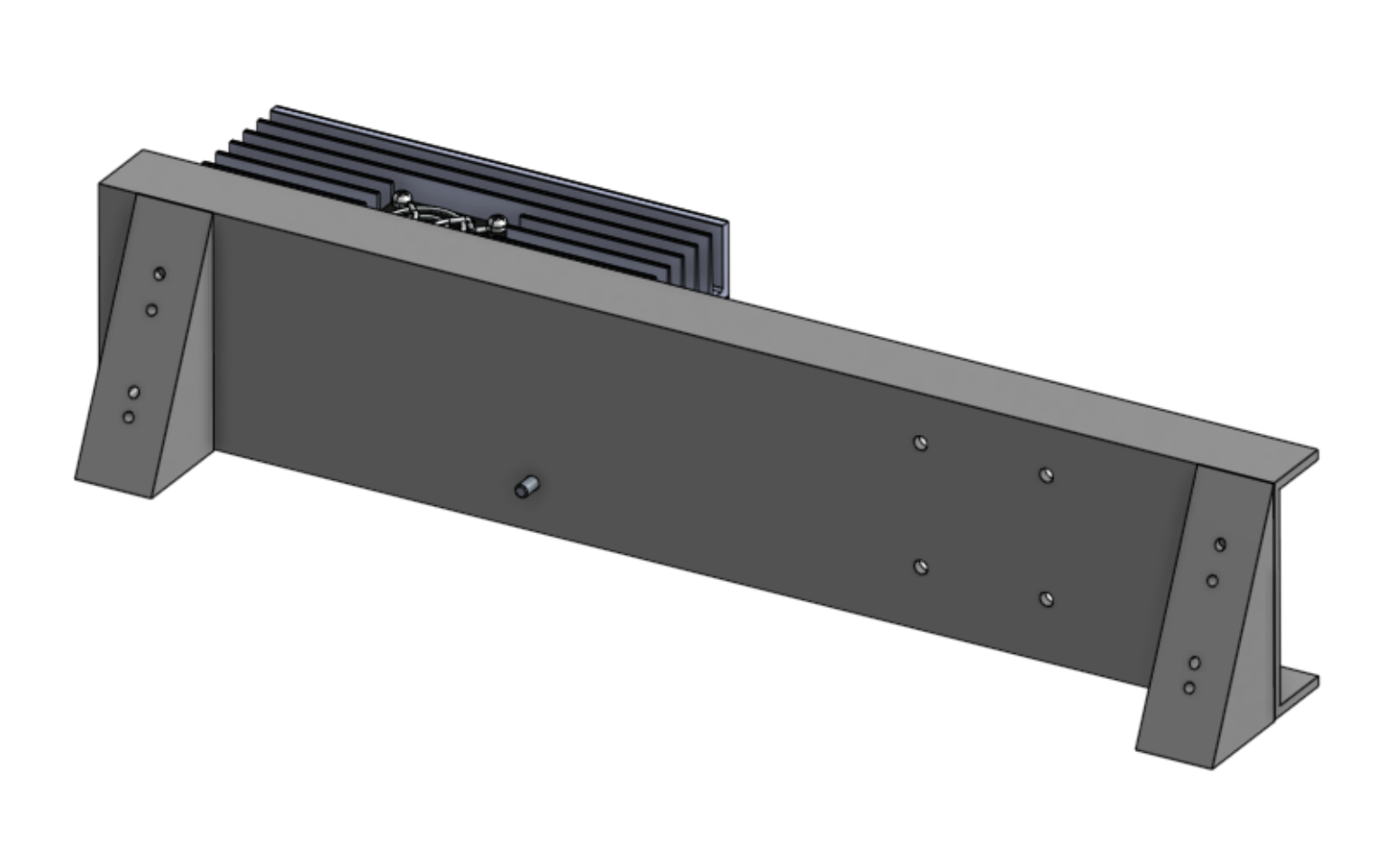
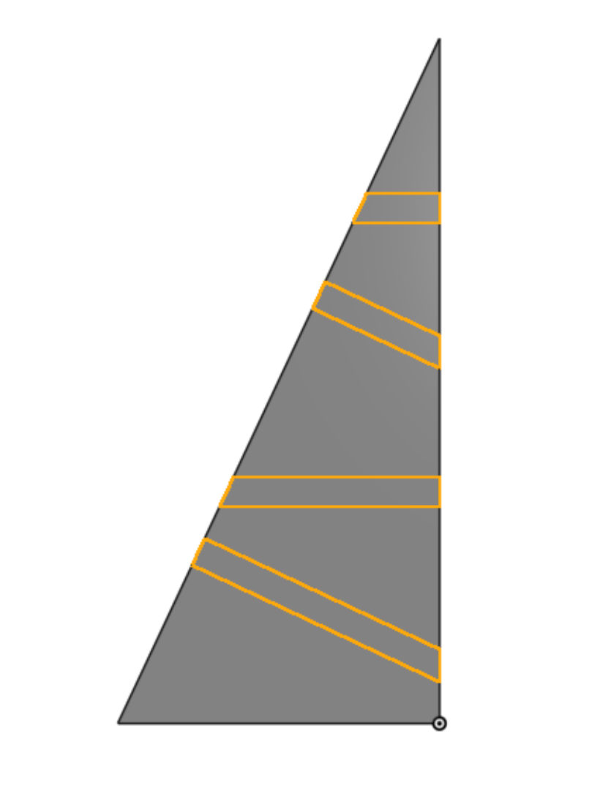
Seat Attachment System
Summer 2026
Allows for mounting of driver (shown) and stepper motor (not shown) on the back of the seat to enable powered swivel.
Assembly includes triangles that attach directly to the back corners of the seat and a bar to hold the driver and motor.

Slide 6
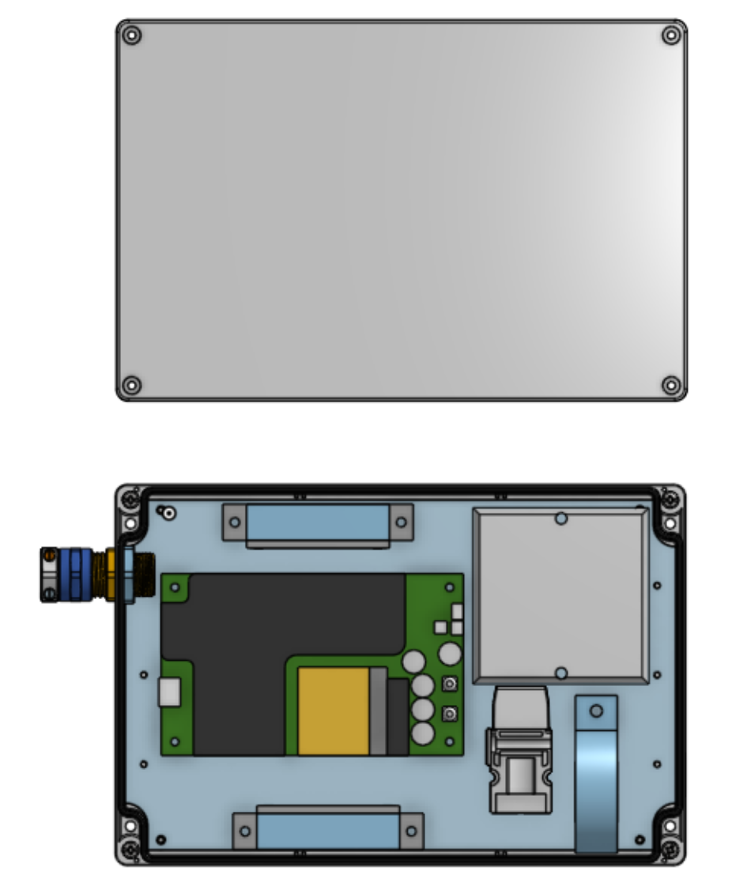
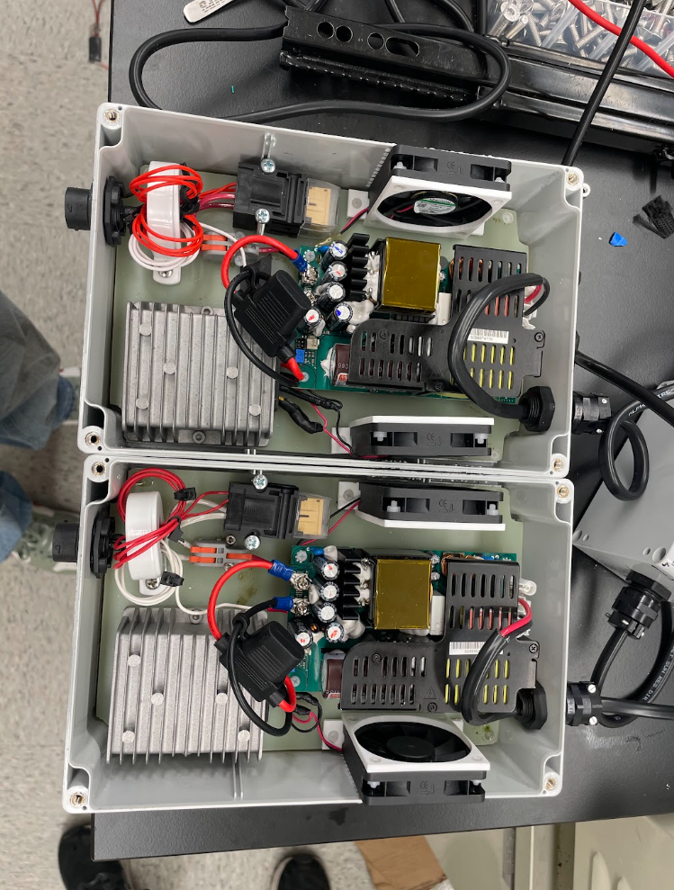
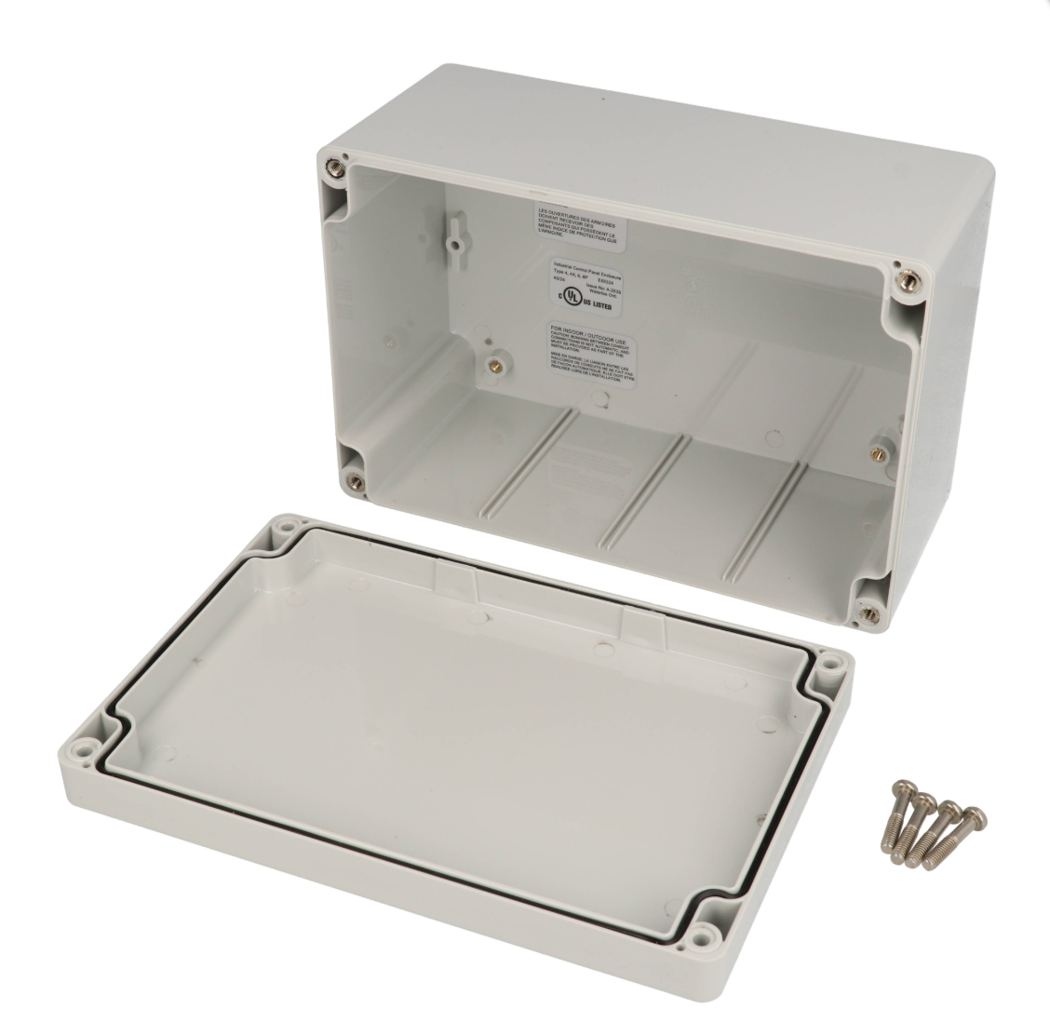
Power Supply box
Spring-Summer 2026
Enclosure to integrate 54V PSU into knee rehab device. Components chosen from online vendors and imported or manually modeled.
HAMMOND Enclosure used
Assembled and wired IRL (x2)

Slide 7
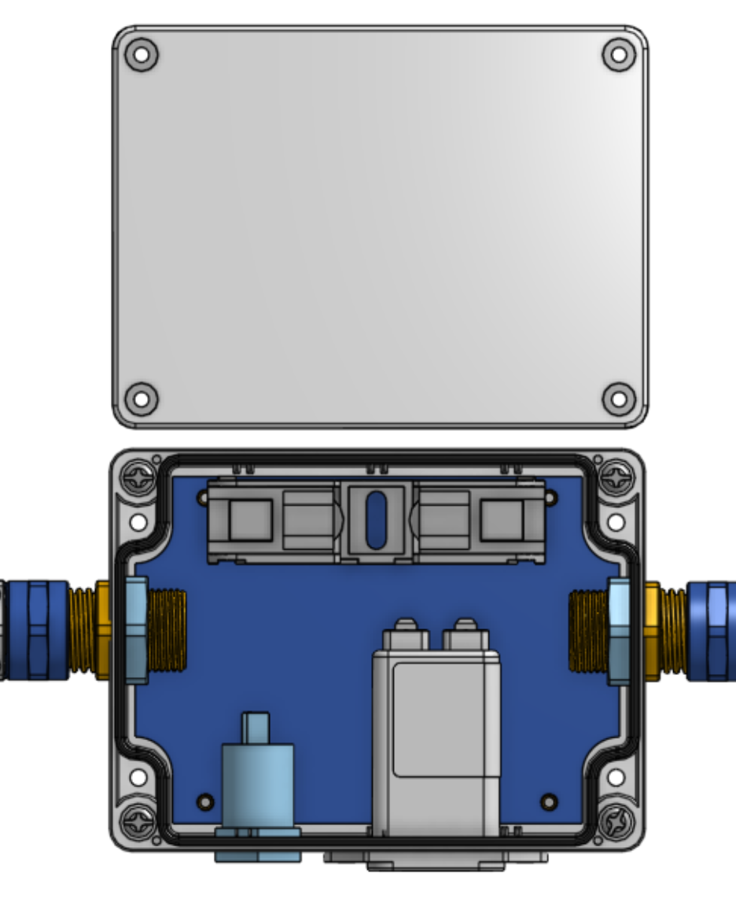
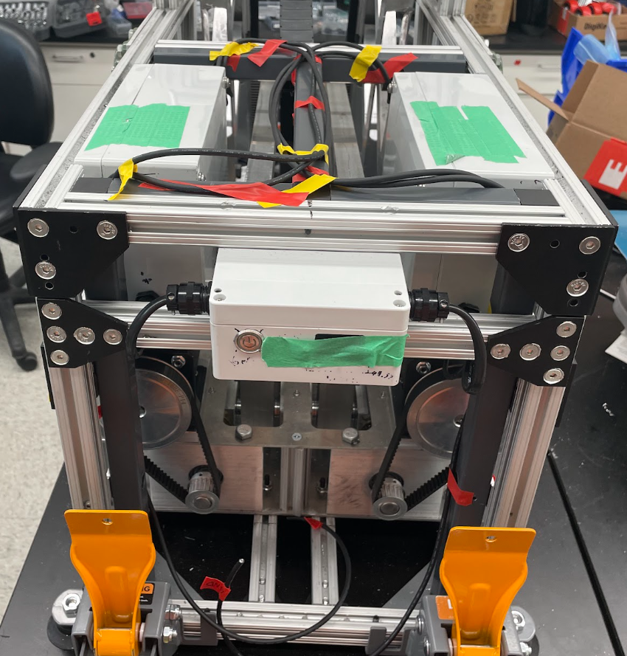
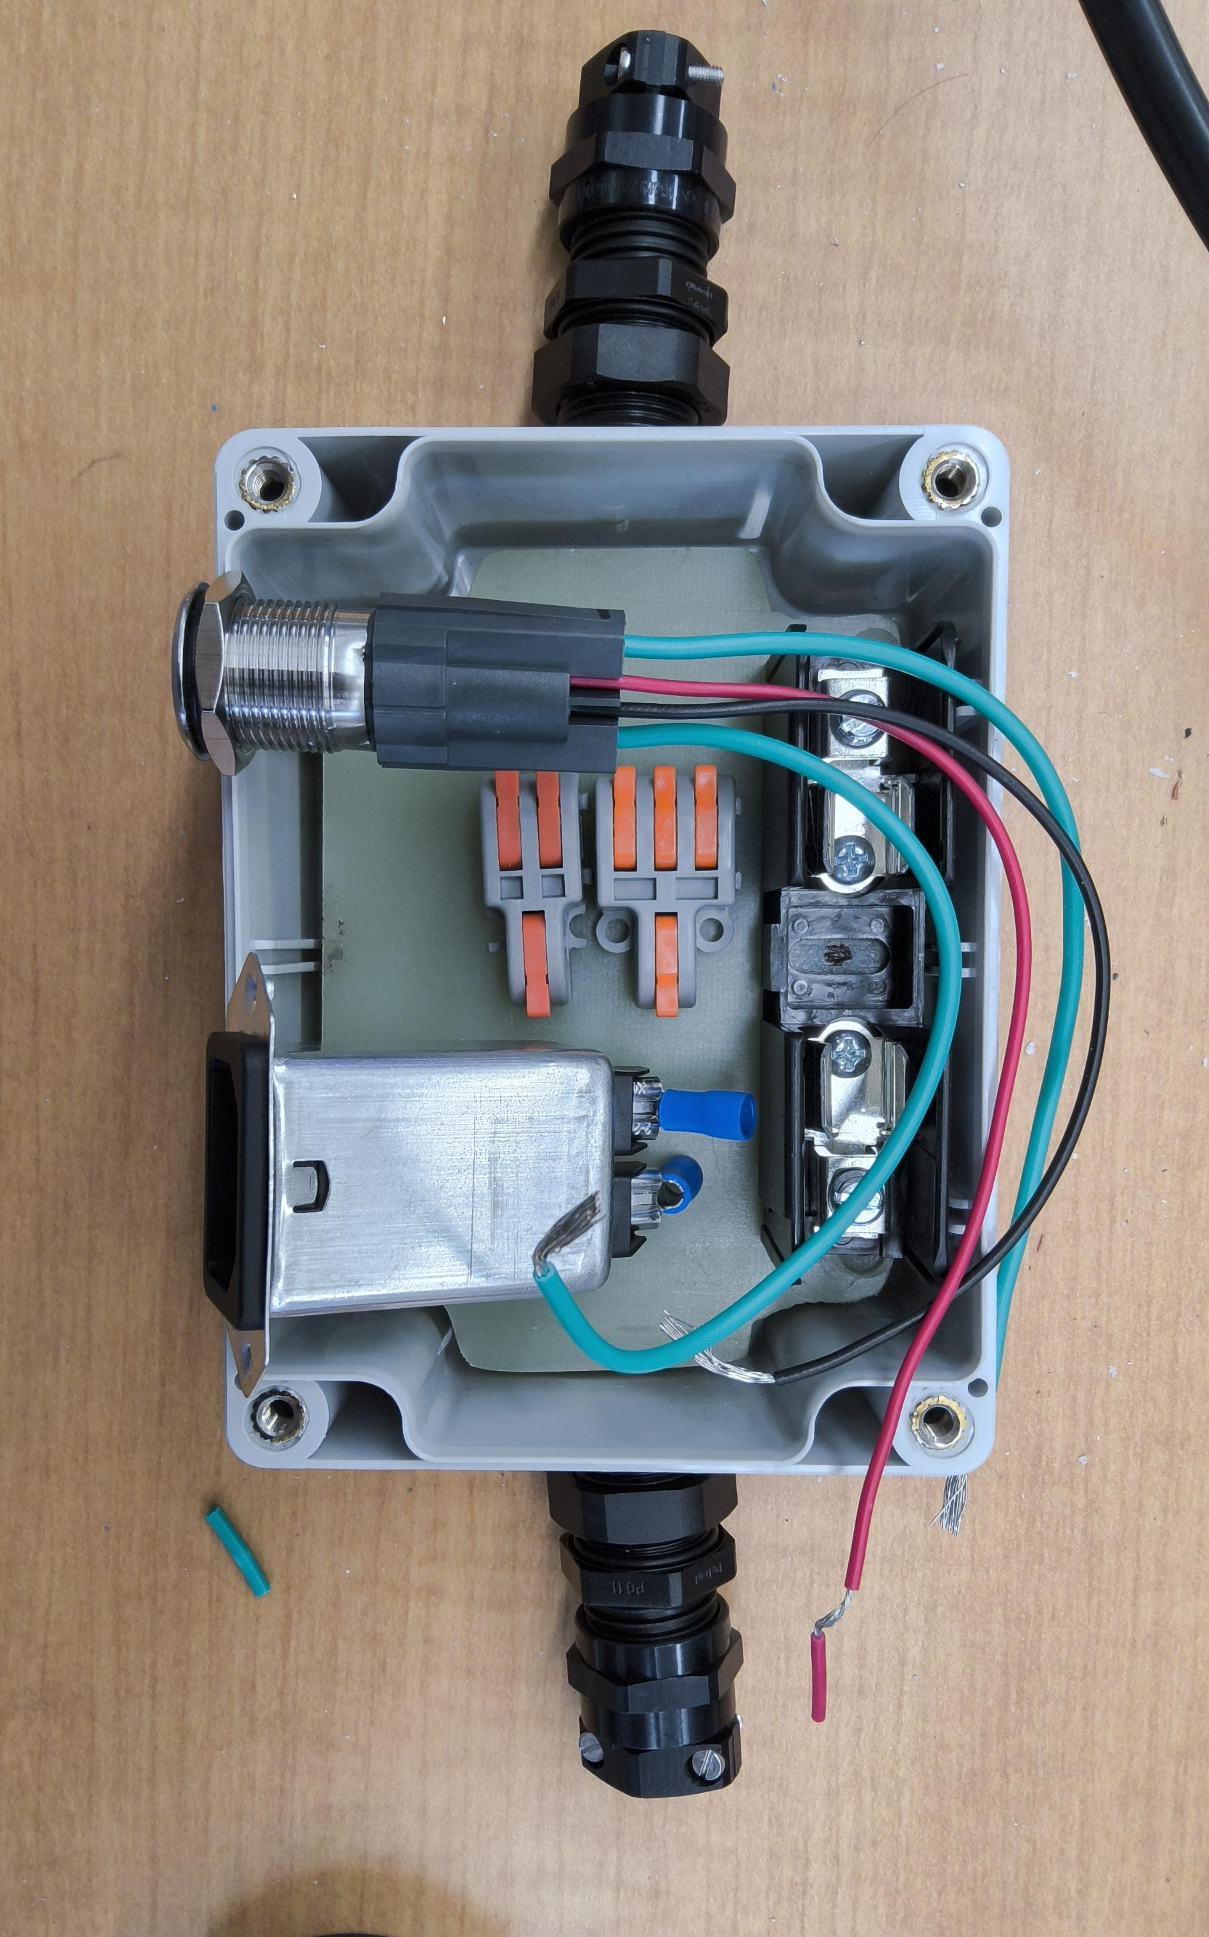
Power Button box
Spring-Summer 2026
Enclosure to support on/off functionality for device as well as detachable power cord. Integrated connection to Power Supply Boxes.
Assembled and wired IRL

Slide 8
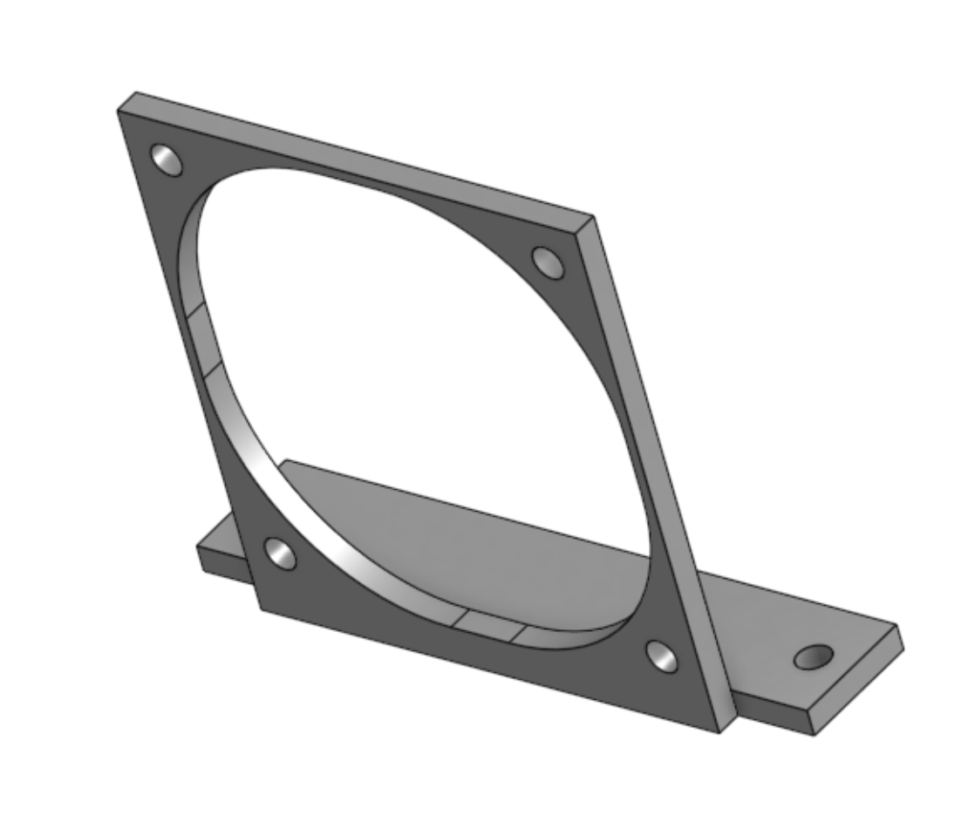
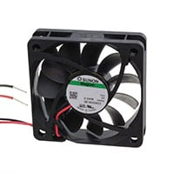
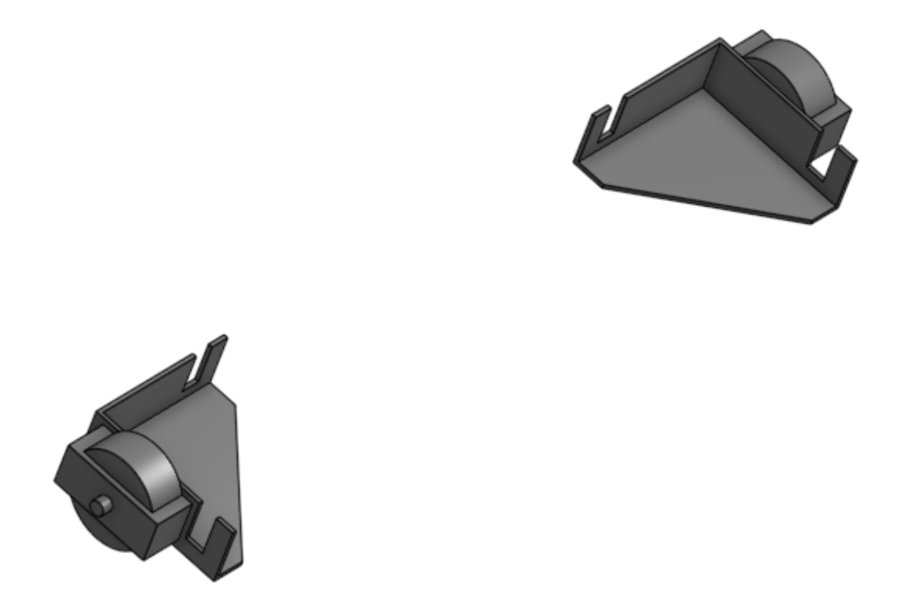
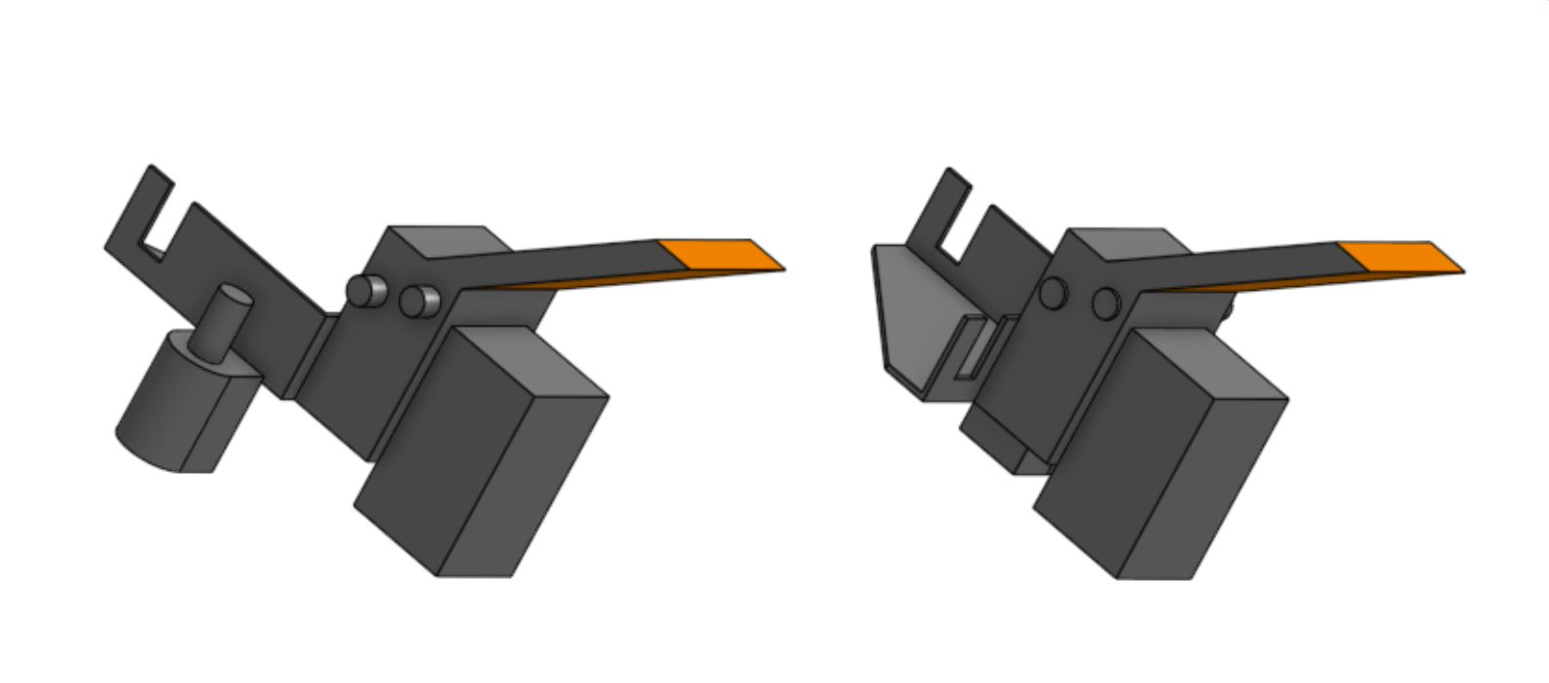
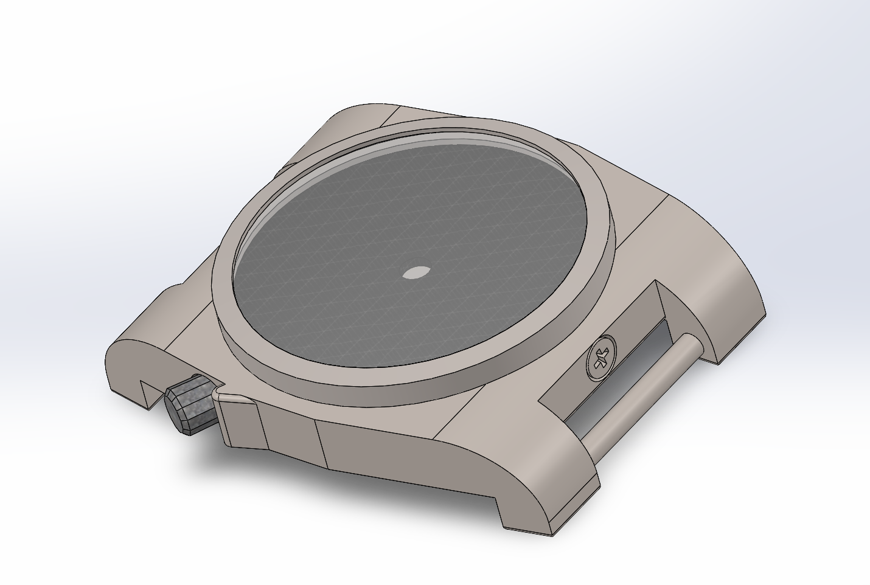
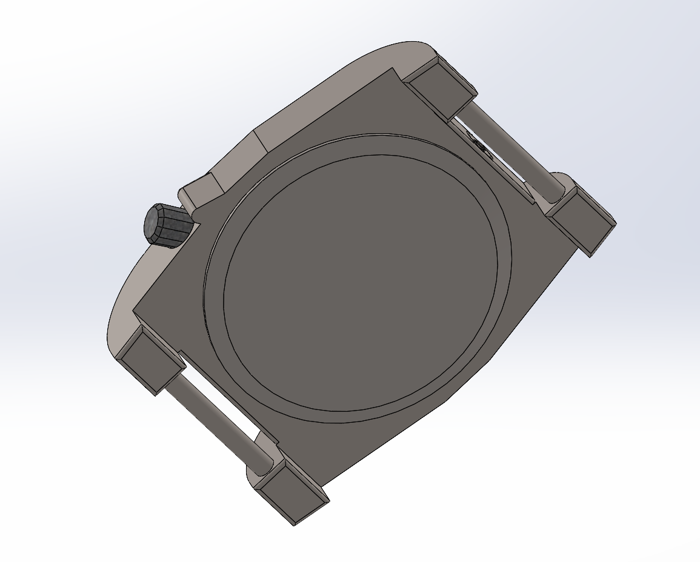
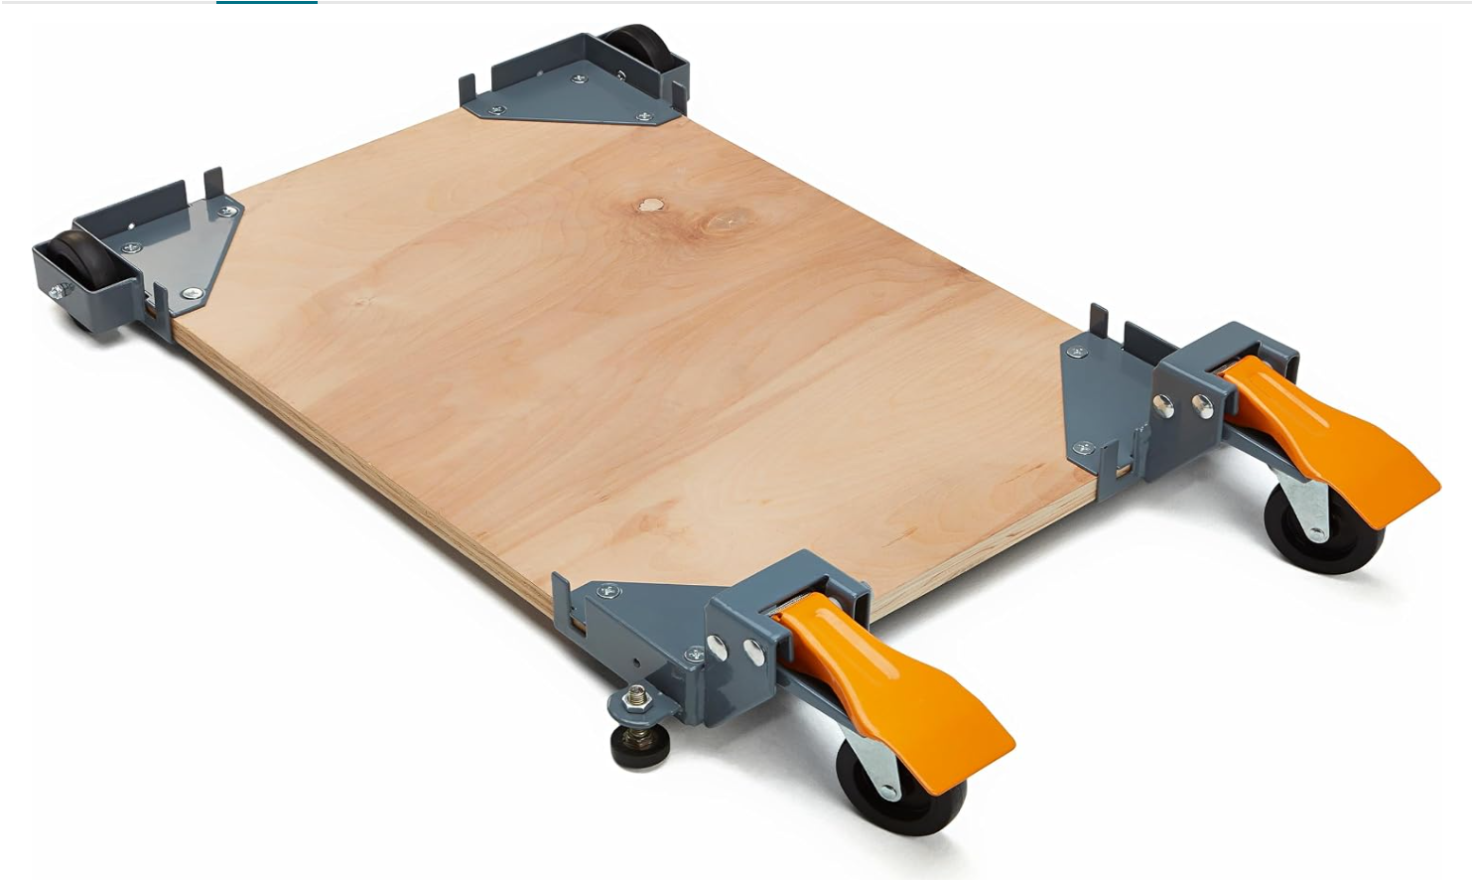
Misc. Models
Custom fan holders
Original Watch Face design
Modeled the wheels used in device for incorporation into master assembly.
<- Actual product image

